Slide 1
Interborough Express Line
Group 2
Tony Jose, Saachee Deshmukh, Agaaz Oberoi, Parthkumar Kanani, Jiaqi Guo
05/11/2023

Slide 2
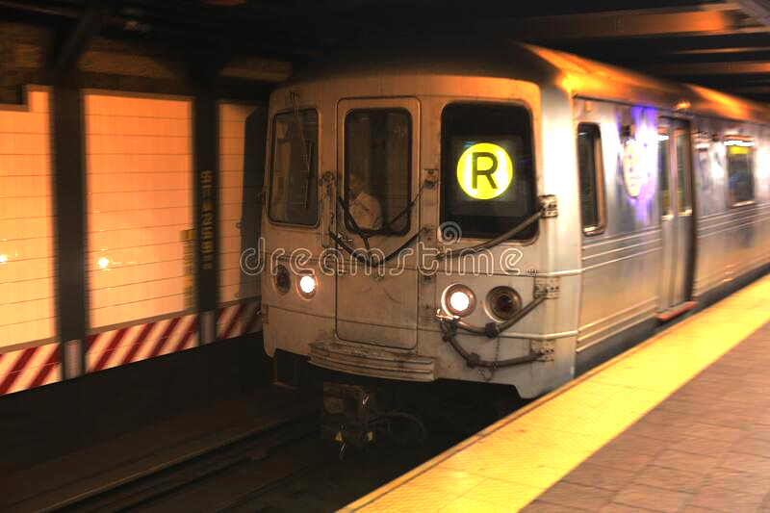
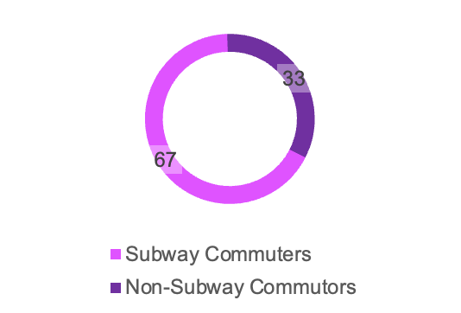
Scenario
New York’s public transportation system has been primarily built to allow workers to travel to Manhattan during the day for work and commute back after work.
NYC Public Transit Usage:
Increasingly more commuters are looking to travel between the boroughs without having to pass through Manhattan which is the case for most lines and no line (except G) connects the boroughs to each other directly.
Metropolitan Transportation Authority. (2021). Subway and bus ridership 2021. Retrieved May 11, 2023, from https://new.mta.info/agency/new-york-city-transit/subway-bus-ridership-2021

Slide 3
Objectives
Understanding the problem
1
Number of inter-borough commutes between the Bronx, Queens and Brooklyn
Metrics
2
Means of transport used to commute for the above (checked the numbers and proportions, both)
Suggest a fix
(Connect underserved parts of the boroughs)
3

Slide 4
Data Description
USDOT BTS: Means of Transportation to Work
From the 2019 ACS, containing shapefiles for all 50 states with data about workers 16 years and over.
Columns describe the numbers and percentages for various transport means within each census tract.
2011-2015 ACS Commuting Flows
Table containing county-level data in a csv file for all US states and counties.
Columns describe state, county (under the headers residence and workplace) and the number of commuters.

Slide 5



Tools & Technologies
Data Visualization: Python
Matplotlib, folium, geopandas, plotly
Data Cleaning and Analysis
Excel, Python (pandas, numpy, scikit)

Slide 6
Approach and Method

Slide 7
Data Cleaning and Preparation
Renamed and aggregated multiple columns into a few sensible ones
Changed county names and added a prefix in residence counties for Sankey Diagram creation
Used Geopandas to import shapefile and filtered to only include NYC
For Pie Charts, converted coordinates to Web Mercator for better plotting
Dropped unnecessary columns

Slide 8
Method
Clustering:
Used K Means to assign tracts into borough parts.
Visualization:
Used Geopandas for data manipulation.
Created maps with and Folium.
Generated pie charts with matplotlib.
Outcome:
Delivered comprehensive visualizations of NYC commuting patterns.
Enhanced understanding of New Yorkers' commuting habits.
Notes:
K - means - uses the distance between census tracts inside the borough boundaries to divide the boroughs into parts

Slide 9
Dashboard Components

Slide 10
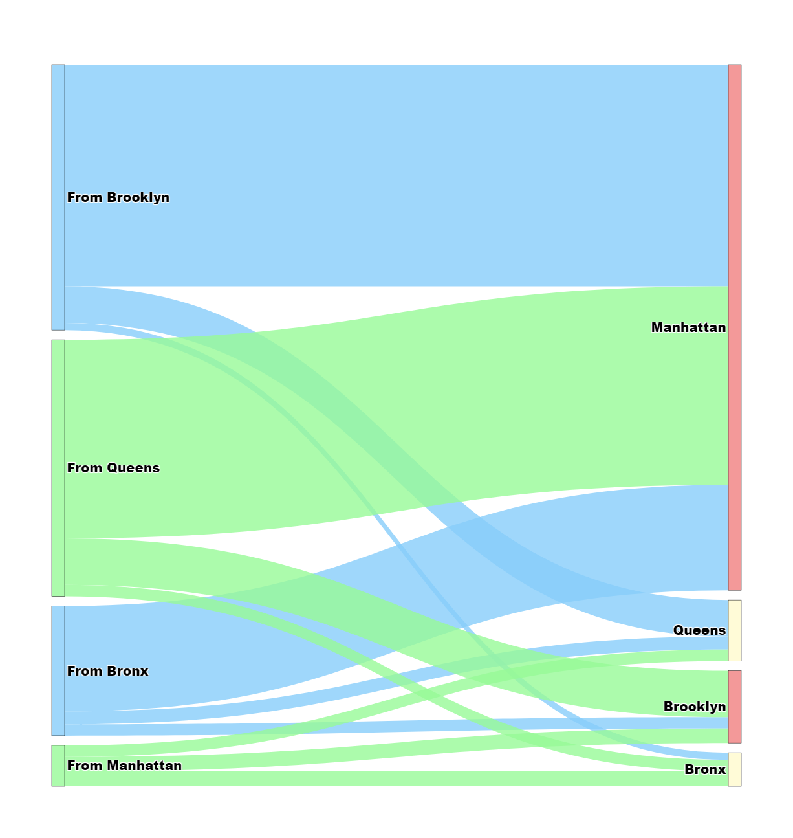
Where are people going?
Around 250k NYC commuters in the inter-borough flow
Excluding Staten Island
U.S. Census Bureau. (2015). Commuting flows. Retrieved May 11, 2023, from https://www.census.gov/data/tables/2015/demo/metro-micro/commuting-flows-2015.html

Slide 11
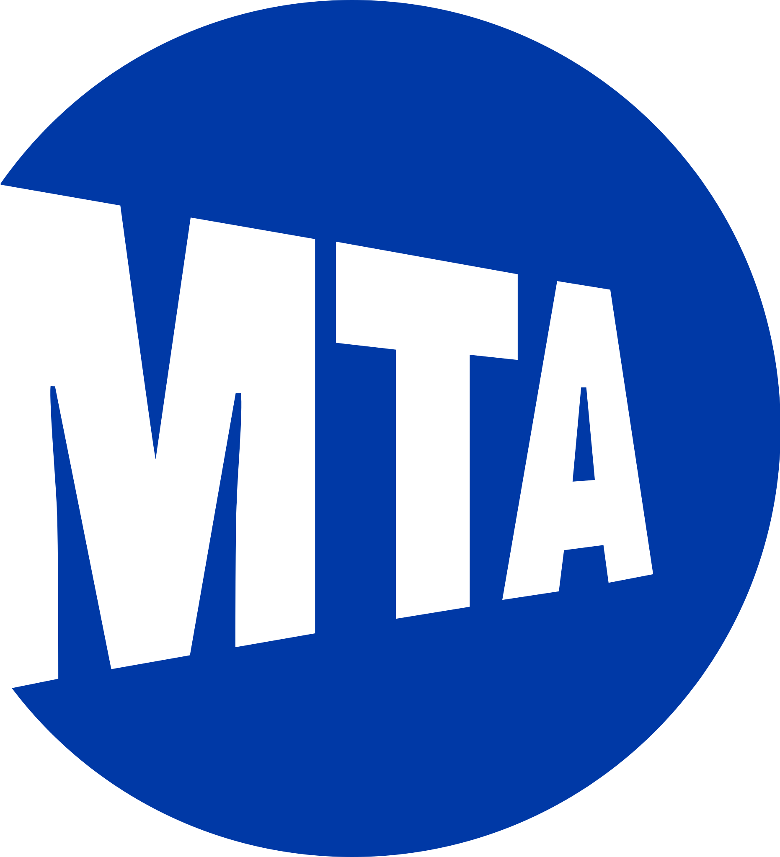
How are people travelling?
Using Means of Transportation Data:
We divided the boroughs of interest into parts based on census tracts’ geographic locations
Visualized the commuting patterns via pie charts using matplotlib and plotted the charts on the borough maps, as shown in the following 3 slides

Slide 12
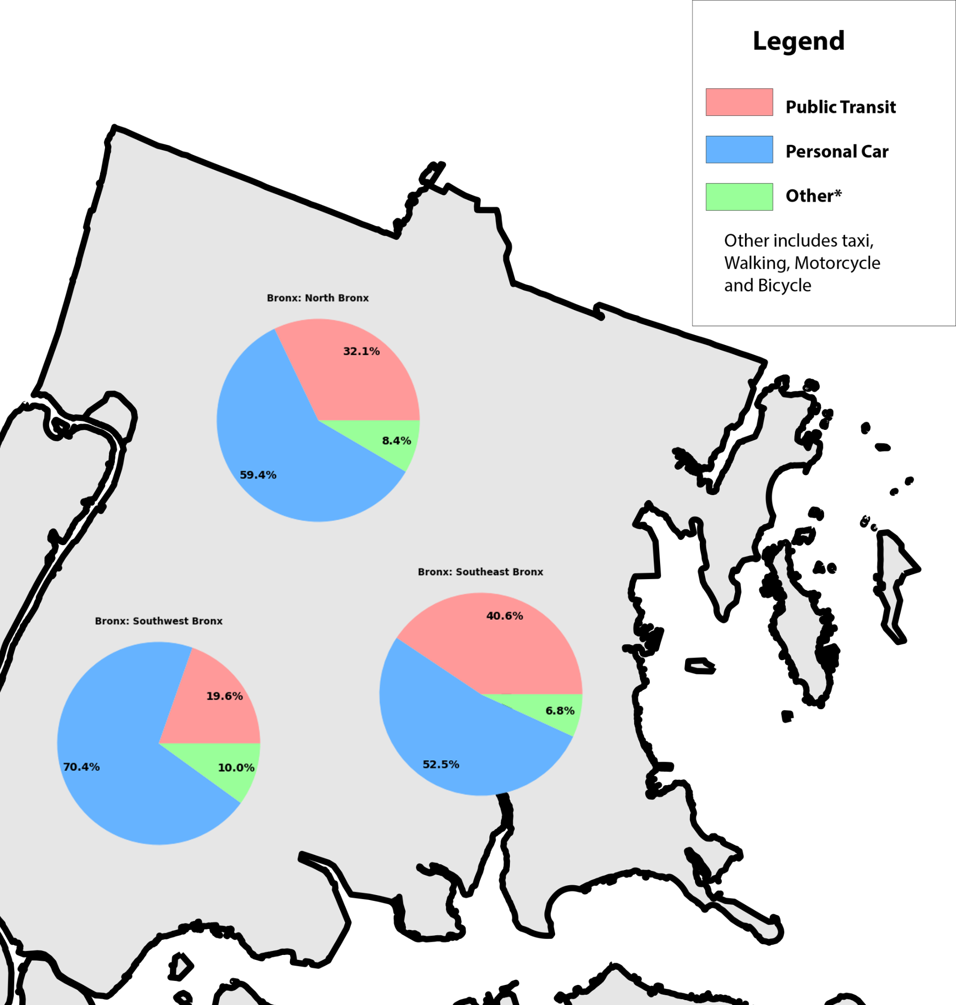
Bronx
Bronx was divided into 3 parts:
U.S. Department of Transportation. (n.d.). Means of Transportation to Work. Retrieved May 11, 2023, from https://geodata.bts.gov/datasets/usdot::means-of-transportation-to-work/explore?location=19.863468%2C0.314300%2C3.31&showTable=true

Slide 13
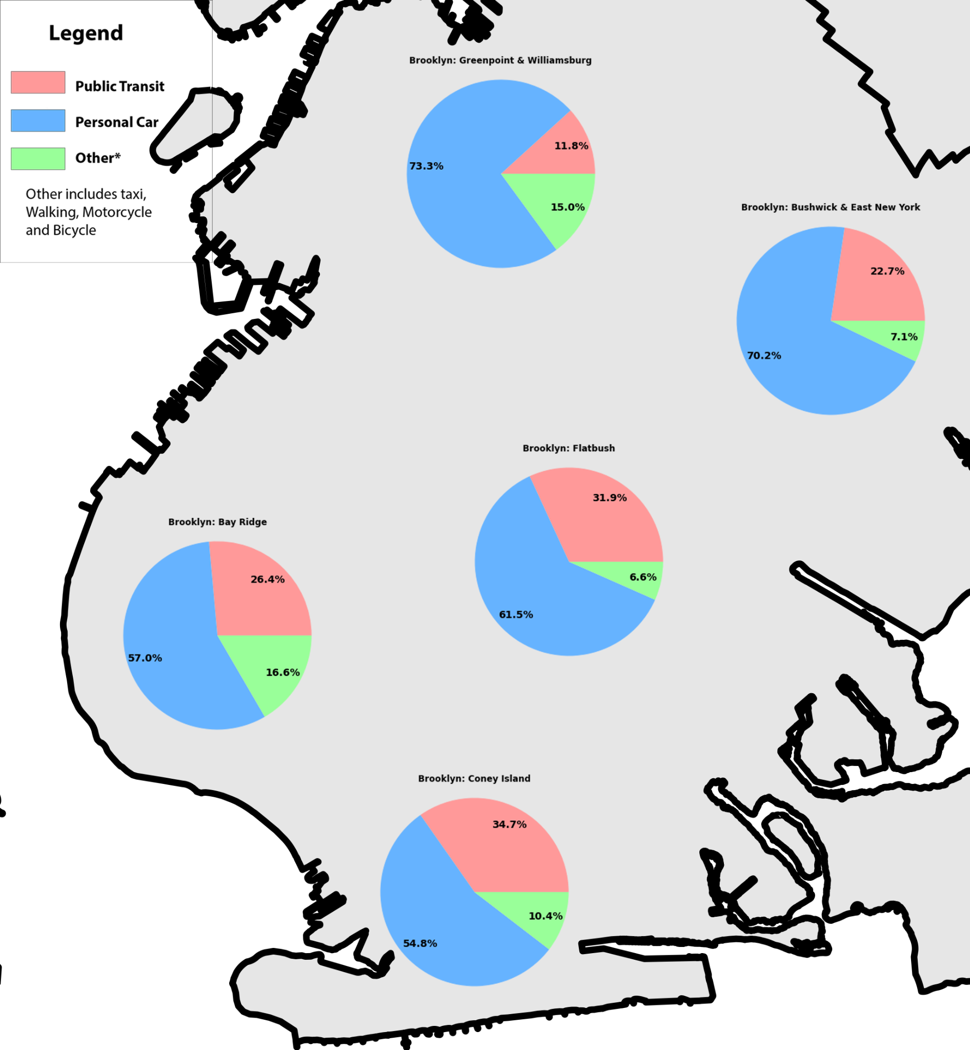
Brooklyn
Flatbush includes Flatbush to Canarsie
Bay Ridge includes the surrounding areas and Sunset Park as well
U.S. Department of Transportation. (n.d.). Means of Transportation to Work. Retrieved May 11, 2023, from https://geodata.bts.gov/datasets/usdot::means-of-transportation-to-work/explore?location=19.863468%2C0.314300%2C3.31&showTable=true

Slide 14
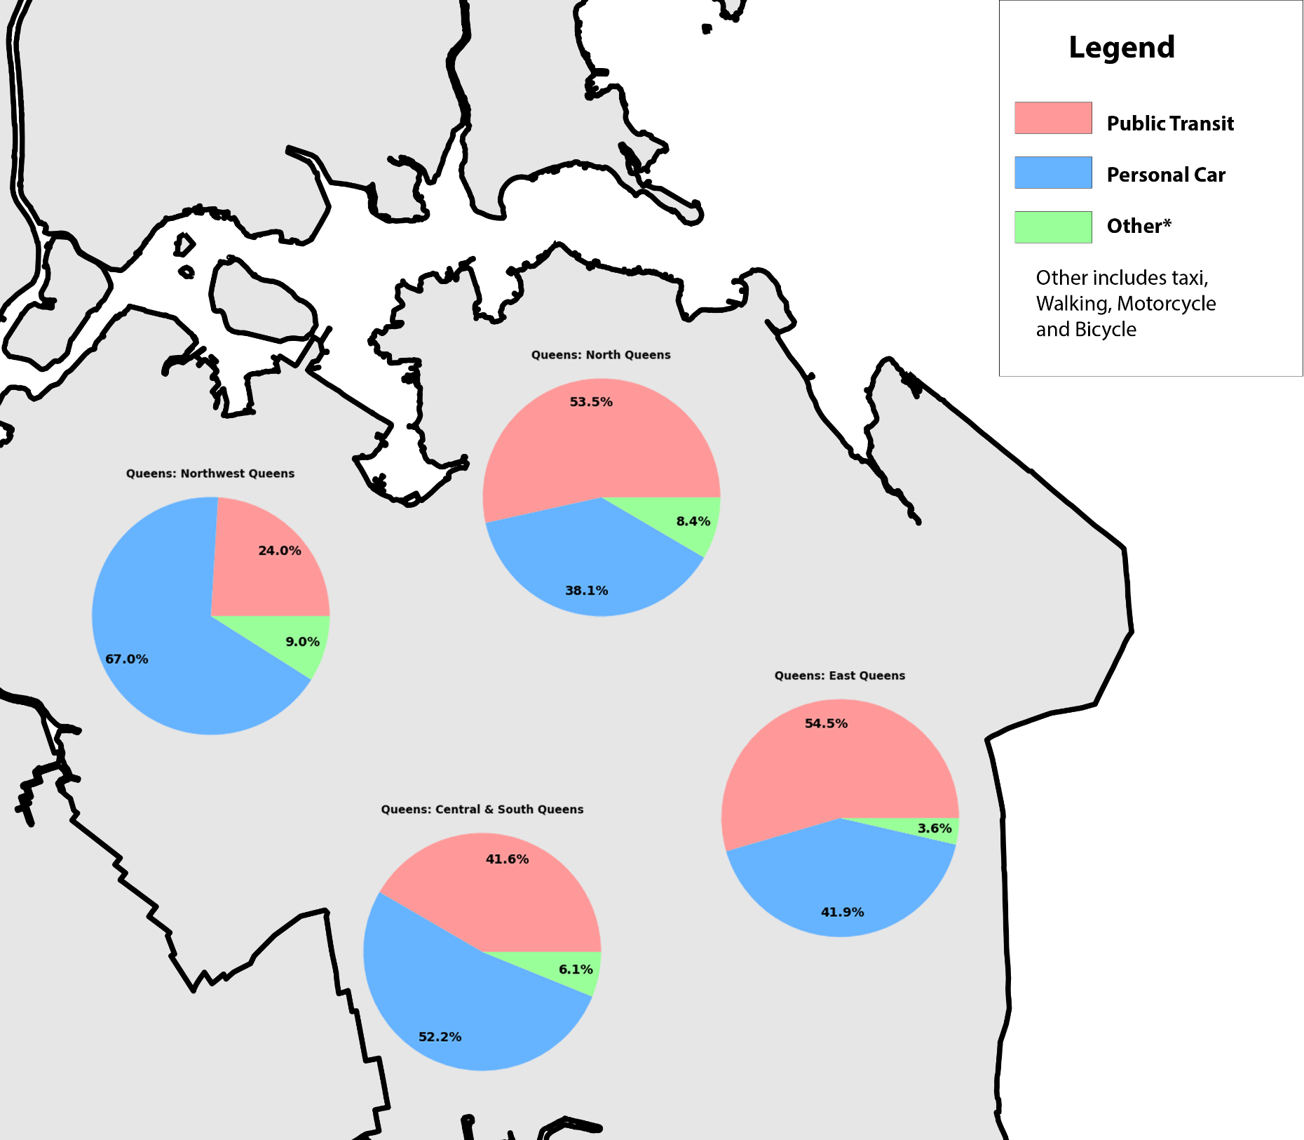
Queens
A majority dependance on public transit is the pattern, and a sizeable number of commuters not going to Manhattan for work
Yet the existing subway system relies on transferring via Manhattan
U.S. Department of Transportation. (n.d.). Means of Transportation to Work. Retrieved May 11, 2023, from https://geodata.bts.gov/datasets/usdot::means-of-transportation-to-work/explore?location=19.863468%2C0.314300%2C3.31&showTable=true

Slide 15
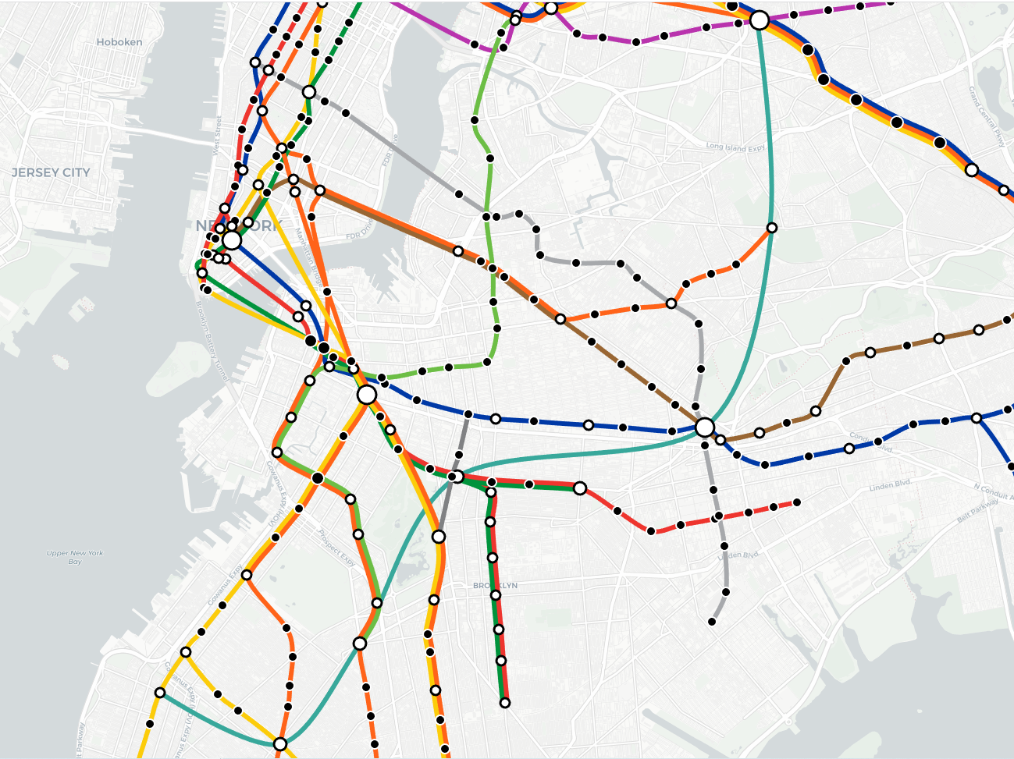
The Interborough Express
Next Steps:
Proposed IBX Route

Slide 16
Proposed Stops | Area | Transfer
Bay Ridge Ave | Brooklyn | R Line
New Utrecht Ave | Brooklyn | D, N Lines
Church Ave | Brooklyn | F, G Lines
Franklin Ave | Brooklyn | 2, 3, 4, 5 Lines
Broadway Junction | Brooklyn | A, C, J, L, Z Lines
Middle Village/ Metropolitan Ave | Queens | M Line
Jackson Heights / Roosevelt Ave | Queens | E, F, M, R, 7 Lines
Proposed IBX Route
Connect to 17 different subway lines

Slide 17
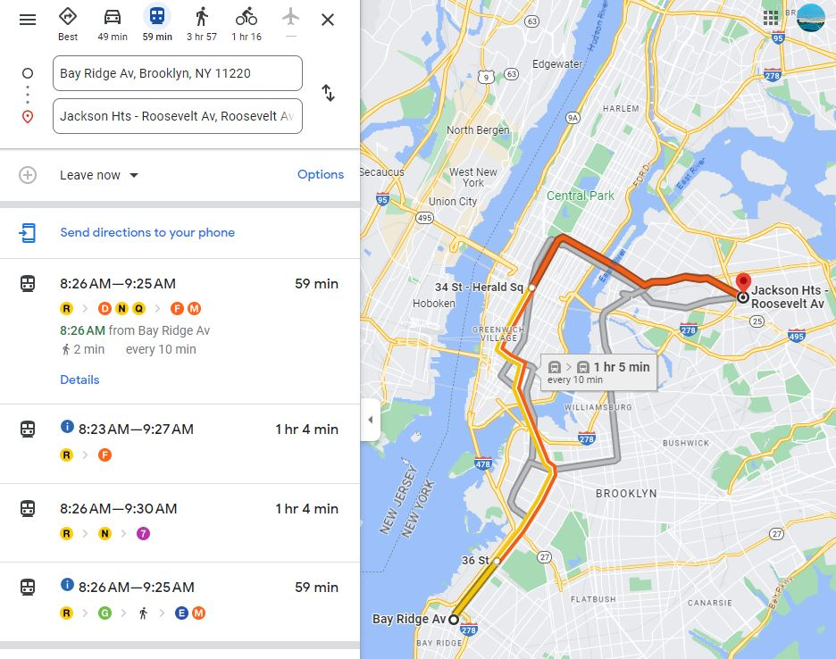
Proposed IBX Route
1 hour
Travel time during peak hours
30 mins
Proposed 30 minutes travel time
15 Stops on average
7 Stops

Slide 18
Thank you!

